Slide 1
Design Best Practices
Jeremy Morris
Department of Operations and Information Systems
University of Utah

Slide 2
Agenda
Guideline for effective data visualization: Consider Affordances, Accessibility and Aesthetics
Motivation
Best practices from design
Affordances
Accessbility
Aesthetics

Slide 3
Motivation | Design Discipline Learnings
Concept: Several best practices from Design Discipline should be considered for Data Visualization
The Design Discipline has been active in research and practice for quite some time
Data visualization practioners and researchers can benefit from those who have “blazed trail”

Slide 4
Design Principle: Affordance
Form follows function. For data viz, this means…
Highlight the important stuff
Eliminate distraction
Create clear hierarchy of information
Notes:
Affordance: clues about how an object should be used. Door handle a good example.

Slide 5
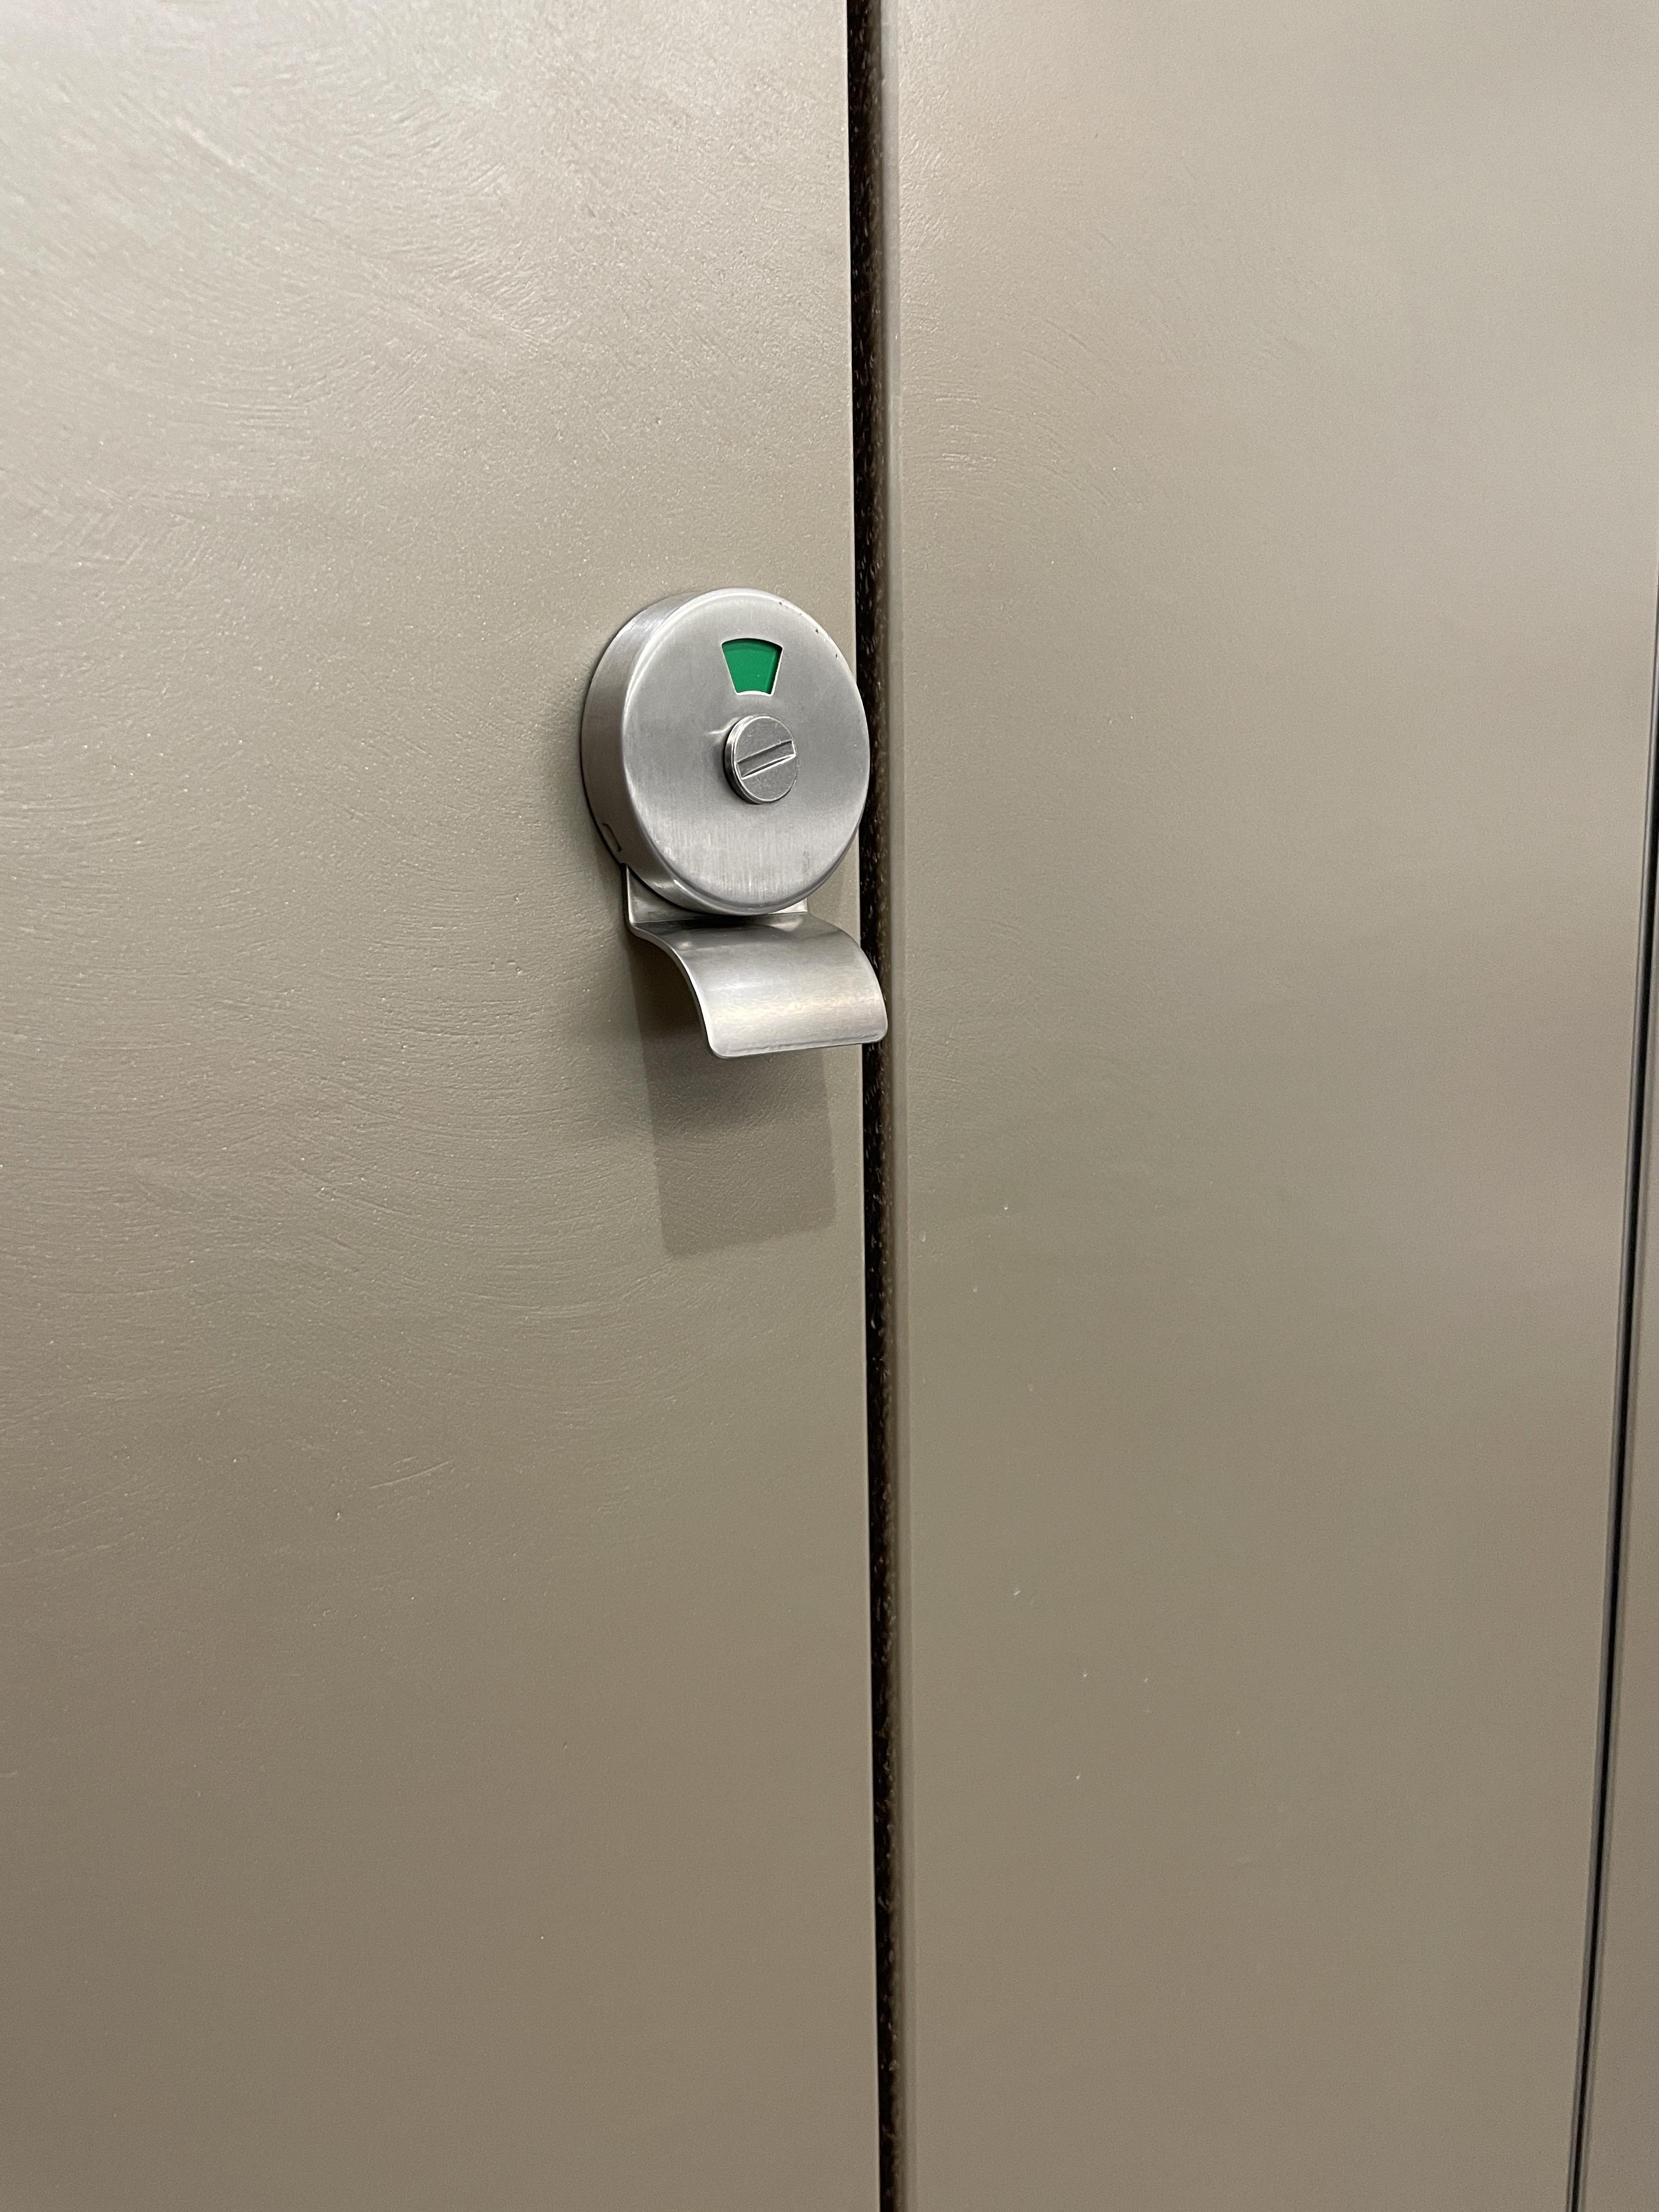
Push or Pull?

Slide 6
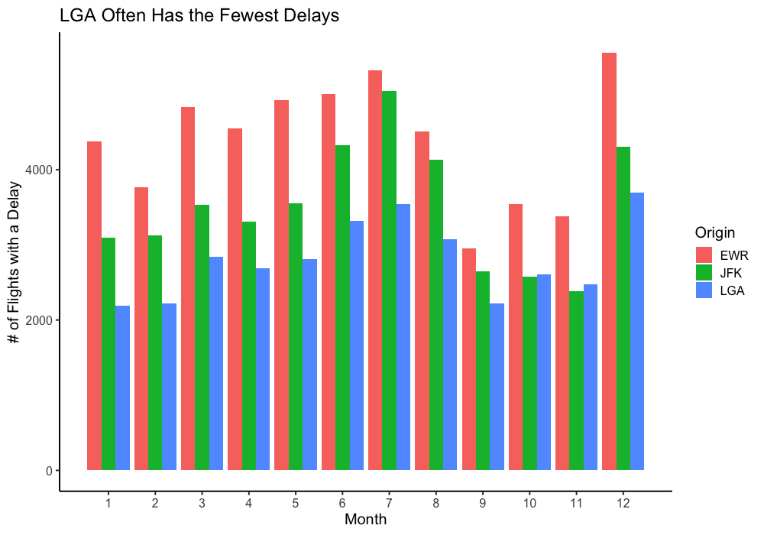
Highlight Important Stuff
Notes:
What do you think is important about this data?
How easy is it to see that LGA has the fewest delays?
What might you do?

Slide 7
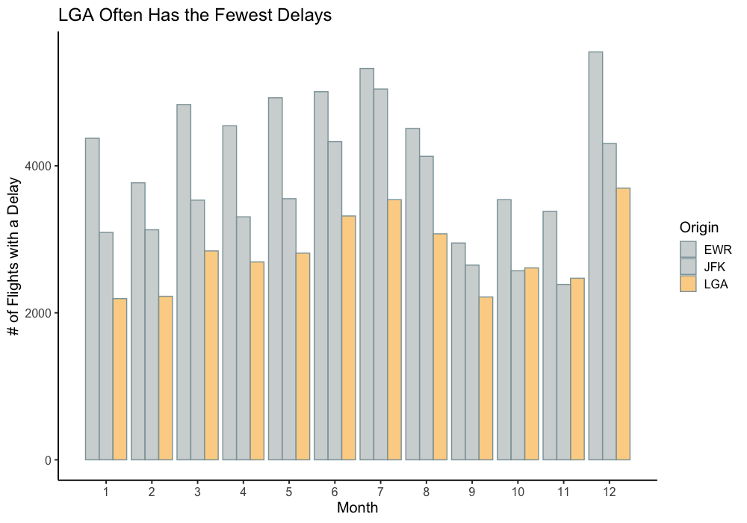
Highlight Important Stuff
Notes:
What are some other ways we can highlight things?

Slide 8
Other considerations (text)
Bold, italics, underlining
sparing use of italics and underlining
CASE and typeface
using all upper case can highlight text quickly.
Avoid using different fonts.
Color
Effective especially when also making text bold.
Inversing elements
Be careful you don’t make it look like a 90’s website
Size
Also useful to attract attention

Slide 9
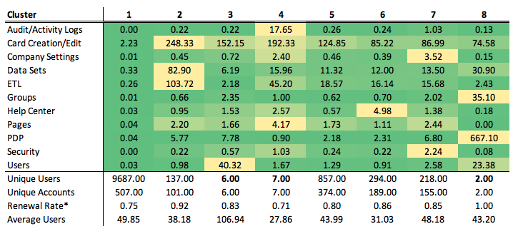
Eliminate Distraction
When detail isn’t needed, summarize:
Notes:
Too much going on
What do you notice? How long would it take you to summarize the clusters?
This table shows profiling means for a cluster algorithm used to find specific kinds of users and shows the maximum amount of detail needed for this analysis.

Slide 10
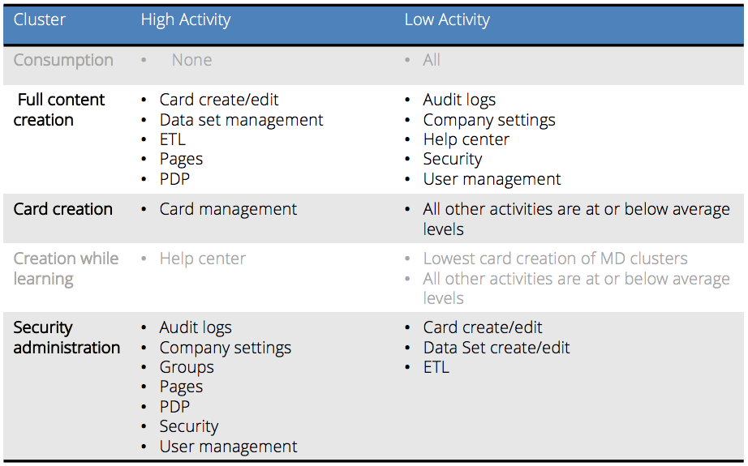
Summarize when detail not necessary
This is the final visualization.
Notes:
What do you notice here?
Numbers – gone
Heat map – gone
All detail – gone
Just words and only the right words
Also use of color to de-emphisize the things I don’t really care about

Slide 11
Eliminate Distractions

Slide 12
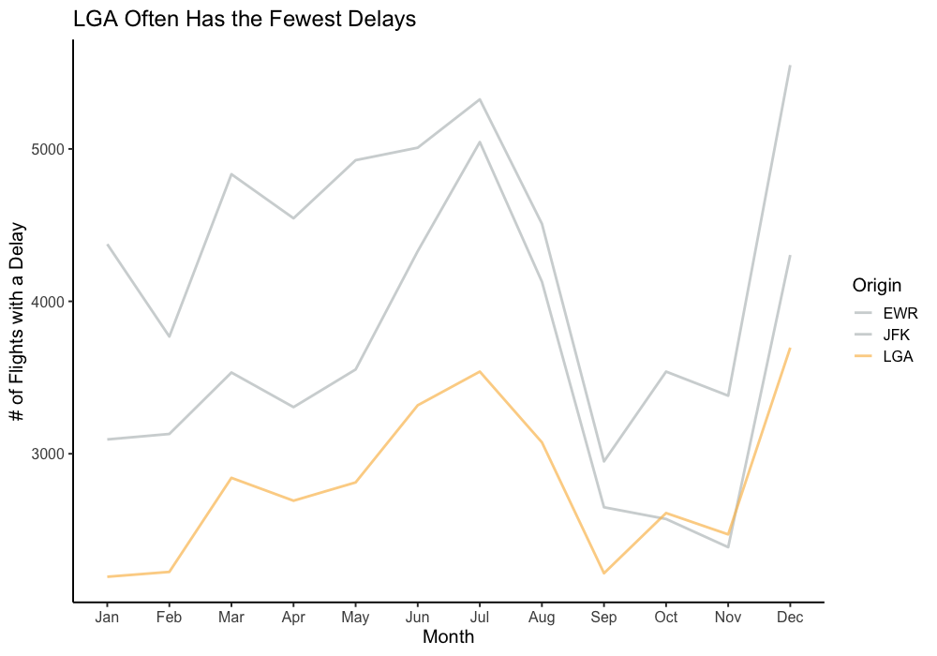
Eliminate distractions
Push unnecessary information to the back.
Notes:
First, change the chart type to something that helps with your message
Remove needless gridlines
Change the x-axis so it is readable by humans
Label axes

Slide 13
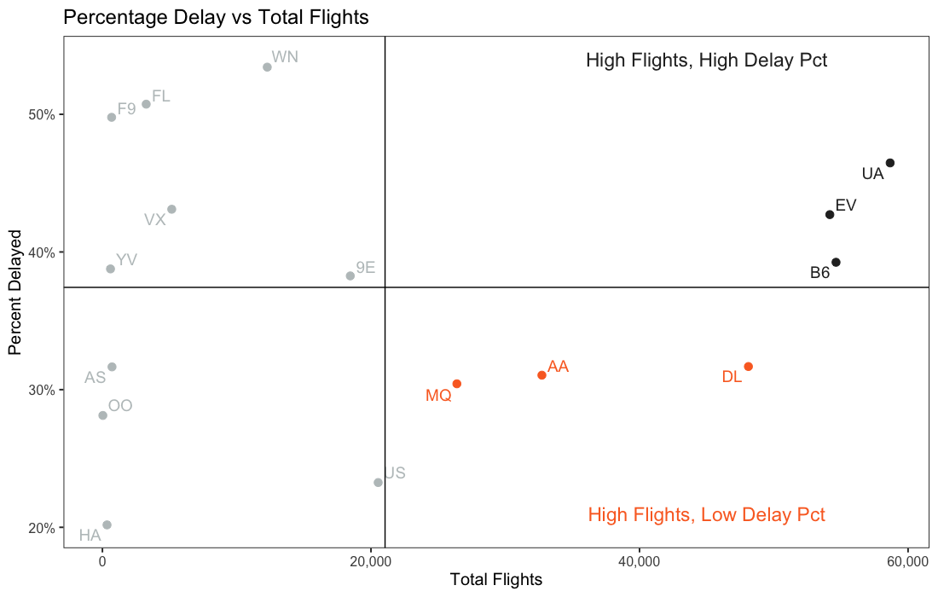
Create visual hierarchy
Notes:
What have we done here to aid in understanding?

Slide 14
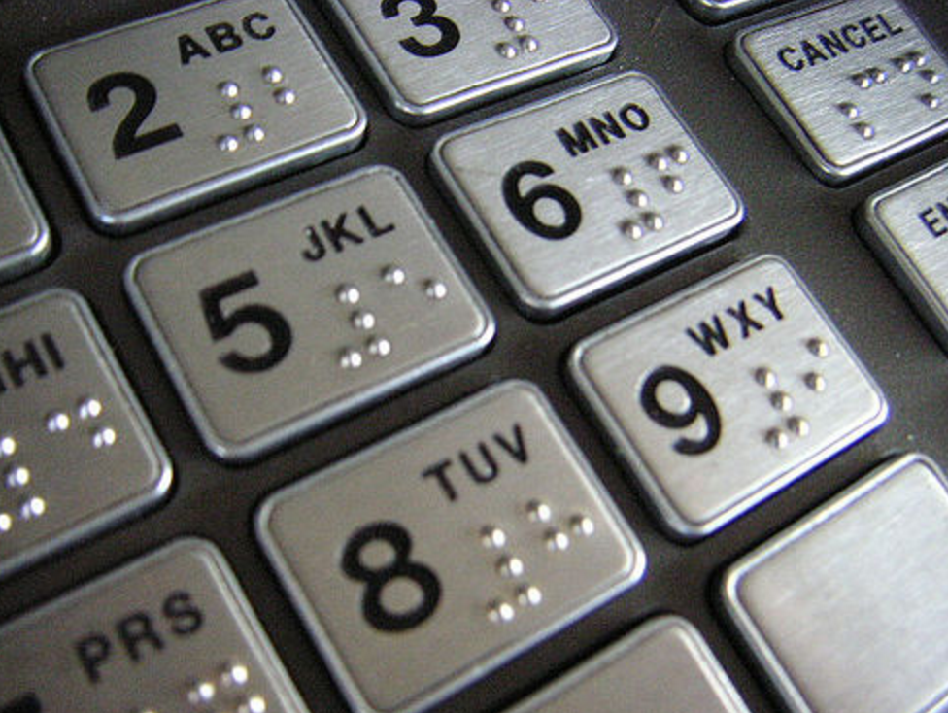
Best practices from Design Discipline| Accessibility
Accessibility: designs should be usable by people with diverse abilities
Considerations for Data Visualization
Simplify
Consistent, easy-to-read font
Use straight-forward language
Explain esoteric terms and acronyms
Use text effectively
Every chart needs a title
Every axis (almost always) needs a title
Different readers may interpret differently
If the same interpretation is desired, use text to state it clearly
The title (top-left) is the first item readers see; use it effectively
Use labels to direct users:
To act (explanatory)
To different items of interest (exploratory)
Be aware of colorblindness.
Most common: Green/red
Second: Blue/yellow
Don’t create charts that contrast those colors. (May be tough with red/green.)

Slide 15
Best practices from Design Discipline| Aesthetics
Concept: the more aesthetically pleasing the design, the more likely readers will engage
Considerations for Data Visualization:
Leverage other aesthetically pleasing designs
Intentional usage of color
Clean lines
Leverage whitespace

Slide 16
Best practices from Design Discipline| Aesthetics (cont’d)
The effect of aesthetic on the usability of data visualization.
Read (10 minutes)
Discuss (5 minutes)

Slide 17
References
Nussbaumer Knaflic, C., “storytelling with data”, Wiley (2015)

Slide 18
Appendix

